Slide 1
Lab Paket Hemat
Sidoarjo – 5 November
Presented By: Andika Triwidada

Slide 2
Apa

Disk
20 GB
Membangun lab pada perangkat dengan kapasitas terbatas

RAM
4 GB

Network
virtual

Slide 3
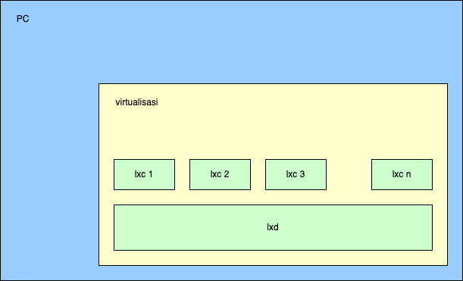
Bagaimana
Pasang software virtualisasi, misal VirtualBox (opsional)
  Buat VM di bawah virtualisasi
Lab dibangun dengan memasang beberapa container sesuai kebutuhan
  Container memakai lxc, yang dipasang di bawah lxd

Slide 4
Membuat container baru dengan OS Ubuntu
vmhost$ lxc launch ubuntu:22.04 nama_kontainer
vmhost$ lxc exec nama_kontainer bash
vmguest# apt update; apt upgrade

Slide 5
Membuat container baru dengan berbagai OS lain
melihat daftar image
lxc image list images: -f compact -c ldast | less
pilihan OS yang tersedia:
  Alpine
  Archlinux
  Busybox
  Centos
  Debian
  Devuan
  Fedora
  Gentoo
  Kali
  Mint
  Opensuse
  Openwrt
  Oracle
  Rockylinux
  Ubuntu

Slide 6
Ukuran container
Alpine 3.16 amd64 (20220901_13:01) alpine/3.16 2.49MB
Busybox 1.34.1 amd64 (20220902_06:00) busybox/1.34.1 1.16MB
Centos 7 amd64 (20220902_07:11) centos/7 84.42MB
Centos 9-Stream amd64 (20220902_07:08) centos/9-Stream 111.00MB
Debian bullseye amd64 (20220902_05:24) debian/11 83.44MB
Fedora 36 amd64 (20220901_20:33) fedora/36 101.12MB
Opensuse 15.4 amd64 (20220831_04:20) opensuse/15.4 43.40MB
Openwrt 21.02 amd64 (20220901_11:57) openwrt/21.02 3.48MB
Ubuntu jammy amd64 (20220827_07:43) ubuntu/jammy 113.32MB

Slide 7
Cek penggunaan disk di vm host
user@pahe:~$ df -h|grep -v tmpfs
Filesystem Size Used Avail Use% Mounted on
/dev/mapper/ubuntu--vg-ubuntu--lv 8.1G 6.1G 1.5G 81% /
/dev/sda2 1.7G 127M 1.5G 8% /boot
user@pahe:~$ lxc launch images:alpine/3.16 c-alpine
Creating c-alpine
Starting c-alpine
user@pahe:~$ df -h|grep -v tmpfs
Filesystem Size Used Avail Use% Mounted on
/dev/mapper/ubuntu--vg-ubuntu--lv 8.1G 6.2G 1.5G 81% /
/dev/sda2 1.7G 127M 1.5G 8% /boot
user@pahe:~$ lxc launch images:fedora/36 c-fedora
Creating c-fedora
Starting c-fedora
user@pahe:~$ df -h|grep -v tmpfs
Filesystem Size Used Avail Use% Mounted on
/dev/mapper/ubuntu--vg-ubuntu--lv 8.1G 6.7G 982M 88% /
/dev/sda2 1.7G 127M 1.5G 8% /boot

Slide 8
Melihat daftar container
user@pahe:~$ df -h
Filesystem Size Used Avail Use% Mounted on
/dev/mapper/ubuntu--vg-ubuntu--lv 8.1G 5.2G 2.5G 68% /
user@pahe:~$ lxc list
+----------+---------+---------------------+-----------------------------------------------+-----------+-----------+
| NAME | STATE | IPV4 | IPV6 | TYPE | SNAPSHOTS |
+----------+---------+---------------------+-----------------------------------------------+-----------+-----------+
| c-alpine | RUNNING | 10.63.80.239 (eth0) | fd42:85f3:d291:b798:216:3eff:fee0:62e9 (eth0) | CONTAINER | 0 |
+----------+---------+---------------------+-----------------------------------------------+-----------+-----------+
| pertamax | RUNNING | 10.63.80.47 (eth0) | fd42:85f3:d291:b798:216:3eff:fe7b:fd37 (eth0) | CONTAINER | 0 |
+----------+---------+---------------------+-----------------------------------------------+-----------+-----------+
user@pahe:~$ lxc stop pertamax
user@pahe:~$ lxc delete pertamax
user@pahe:~$ df -h
Filesystem Size Used Avail Use% Mounted on
/dev/mapper/ubuntu--vg-ubuntu--lv 8.1G 4.0G 3.7G 52% /

Slide 9
Lab: Routing - Persiapan
user@pahe:~$ lxc network create netE -t bridge
Network netE created
user@pahe:~$ lxc network create netF -t bridge
Network netF created
user@pahe:~$ lxc network create netG -t bridge
Network netG created
user@pahe:~$ lxc network list
+--------+----------+---------+----------------+---------------------------+-------------+---------+---------+
| NAME | TYPE | MANAGED | IPV4 | IPV6 | DESCRIPTION | USED BY | STATE |
+--------+----------+---------+----------------+---------------------------+-------------+---------+---------+
| enp0s3 | physical | NO | | | | 0 | |
+--------+----------+---------+----------------+---------------------------+-------------+---------+---------+
| lxdbr0 | bridge | YES | 10.63.80.1/24 | fd42:85f3:d291:b798::1/64 | | 2 | CREATED |
+--------+----------+---------+----------------+---------------------------+-------------+---------+---------+
| netE | bridge | YES | 10.67.106.1/24 | fd42:535b:487e:428d::1/64 | | 0 | CREATED |
+--------+----------+---------+----------------+---------------------------+-------------+---------+---------+
| netF | bridge | YES | 10.59.126.1/24 | fd42:7ac3:62a6:e015::1/64 | | 0 | CREATED |
+--------+----------+---------+----------------+---------------------------+-------------+---------+---------+
| netG | bridge | YES | 10.9.72.1/24 | fd42:aa61:f19b:f3d9::1/64 | | 0 | CREATED |
+--------+----------+---------+----------------+---------------------------+-------------+---------+---------+

Slide 10
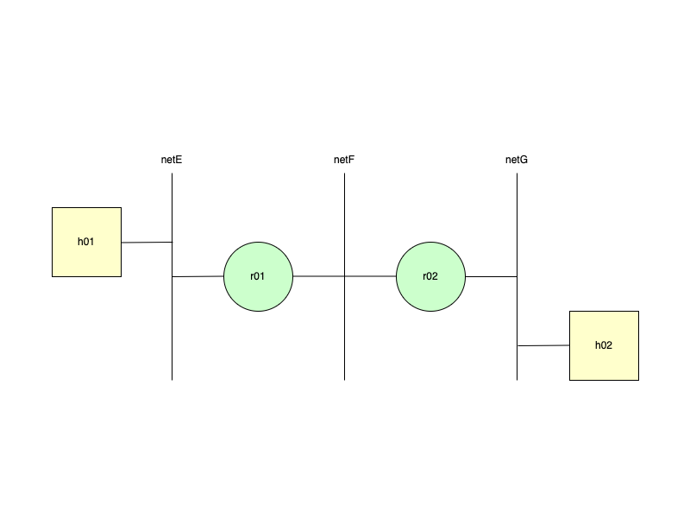

Slide 11
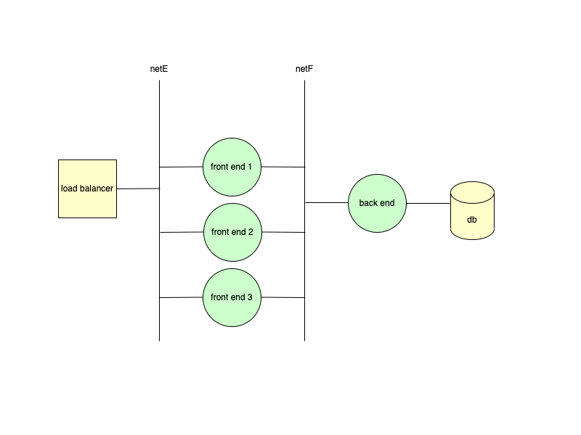

Slide 12
Demo

Slide 13
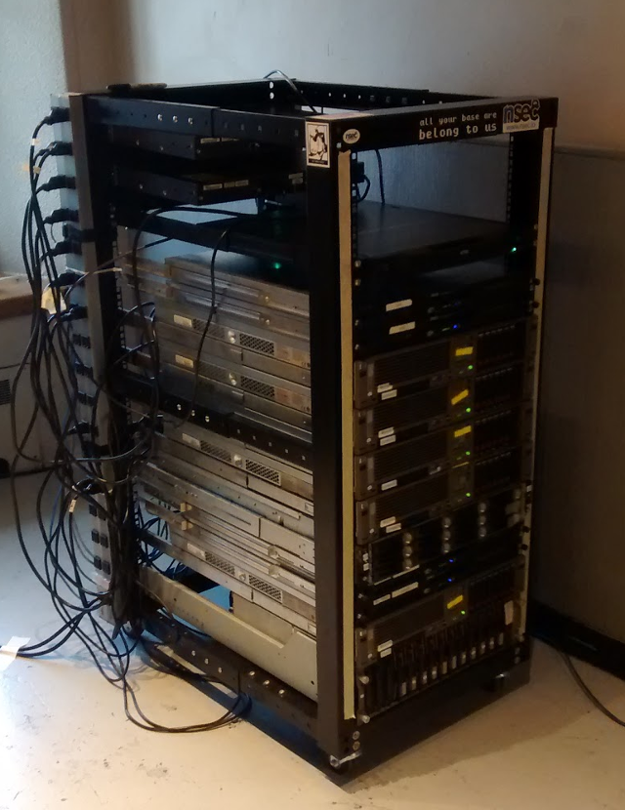
NorthSec 2015 Memakai lxc
Untuk 32 tim mereka menyiapkan:
48.000 virtual network interfaces
2.000 virtual carriers
16.000 BGP routers
17.000 Ubuntu containers
100 Windows virtual machines
20.000 routing table entries

Slide 14
Pahe (US$0) Modal Kartu Kredit
Affan Basalamah
  https://www.youtube.com/watch?v=VlPn7K_Q9cI
  https://academy.apnic.net/en/webinar-courses/using-us0-cloud-infrastructure-for-your-business-survival-92025214386
Oracle Cloud
  4 Arm A1 core, 24 GB RAM; 3.000 OCPU jam + 18.000 GB jam per bulan

Slide 15

Thank you

https://www.ilc.opensuse.id

